Slide 1


Leadership Conference

Slide 2
Activity Disclaimer
The material presented here is being made available by the American Academy of Family Physicians for educational purposes only. Please note that medical information is constantly changing; the information contained in this activity was accurate at the time of publication. This material is not intended to represent the only, nor necessarily best, methods or procedures appropriate for the medical situations discussed. Rather, it is intended to present an approach, view, statement, or opinion of the faculty, which may be helpful to others who face similar situations.
The AAFP disclaims any and all liability for injury or other damages resulting to any individual using this material and for all claims that might arise out of the use of the techniques demonstrated therein by such individuals, whether these claims shall be asserted by a physician or any other person. Physicians may care to check specific details such as drug doses and contraindications, etc., in standard sources prior to clinical application. This material might contain recommendations/guidelines developed by other organizations. Please note that although these guidelines might be included, this does not necessarily imply the endorsement by the AAFP.

Slide 3
It is the policy of the AAFP that all individuals in a position to control CME content disclose any relationships with ineligible companies upon nomination/invitation of participation. Disclosure documents are reviewed for potential relevant financial relationships. If relevant financial relationships are identified, mitigation strategies are agreed to prior to confirmation of participation. Only those participants who had no relevant financial relationships or who agreed to an identified mitigation process prior to their participation were involved in this CME activity.
All individuals in a position to control content for this session have indicated they have no relevant financial relationships to disclose.

Slide 4
Beyond Bylaws: Multilayer Strategies for Avoiding Governance Pitfalls

Slide 5
Introduction
Who we are
Our clients
Major areas of focus

Slide 6

Overview
Governance Ecosystem
The Big Ones: Statutes and Articles
Bylaws
Deeper Cuts
Effective Structure
Avoiding Conflict
Problems
Takeaways
6

Slide 7
Learning Objectives
Explore how multiple levels of governance should overlap and connect in one cohesive system
Learn to avoid conflicts and confusion between various governing documents
Develop skills in crafting effective policies, procedures, codes, and other governance instruments

Slide 8

Bylaws Are Life?

Slide 9

Bylaws Are Life?

Slide 10

Common Misuse of Bylaws
Reactionary provisions
  Address bad behavior
  Resolving ambiguities with excess detail
  Removing Board discretion
Member engagement tools infused into bylaws
  Program and governance committees conflated
  Member rights vs. benefits

Slide 11
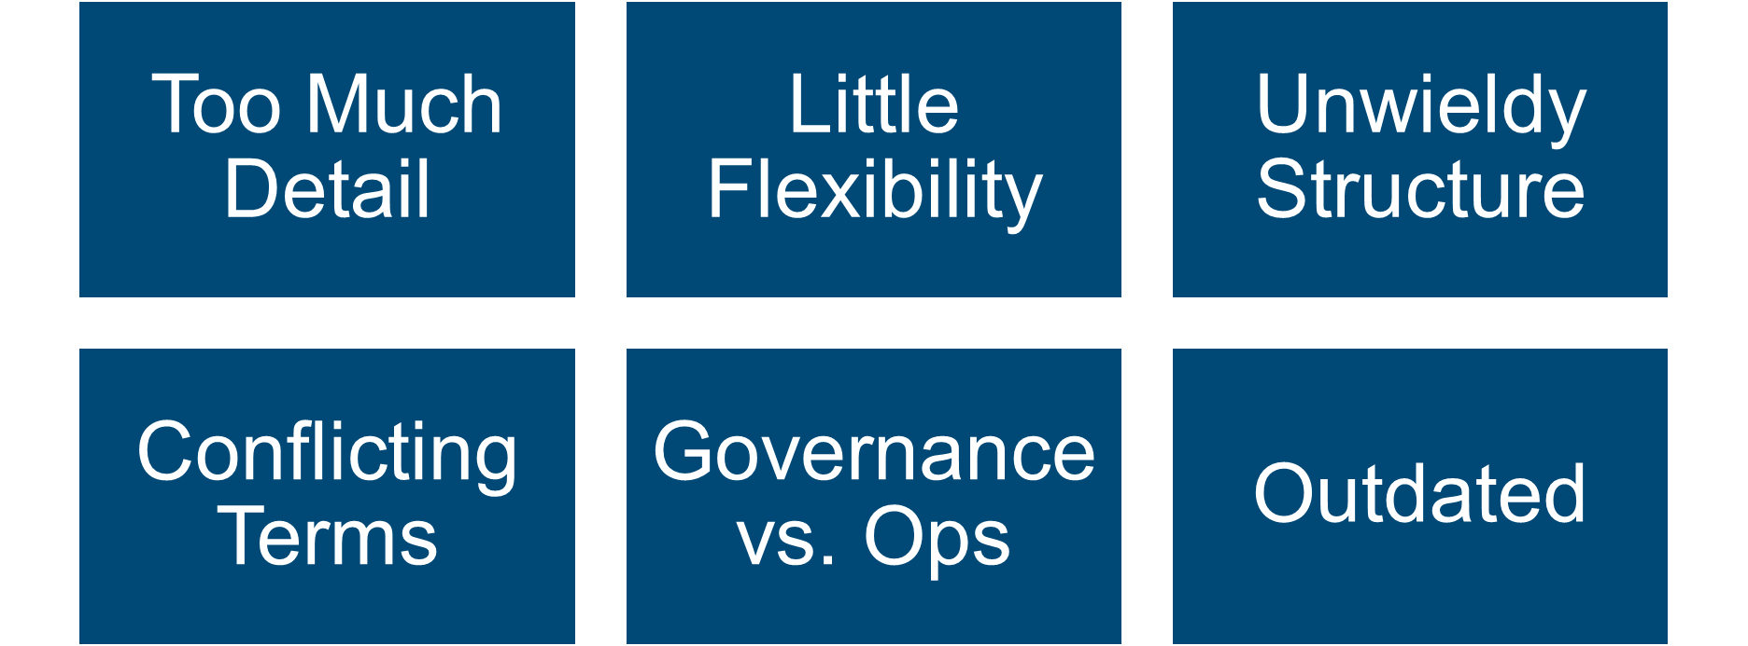
Common Bylaws Flaws

Slide 12
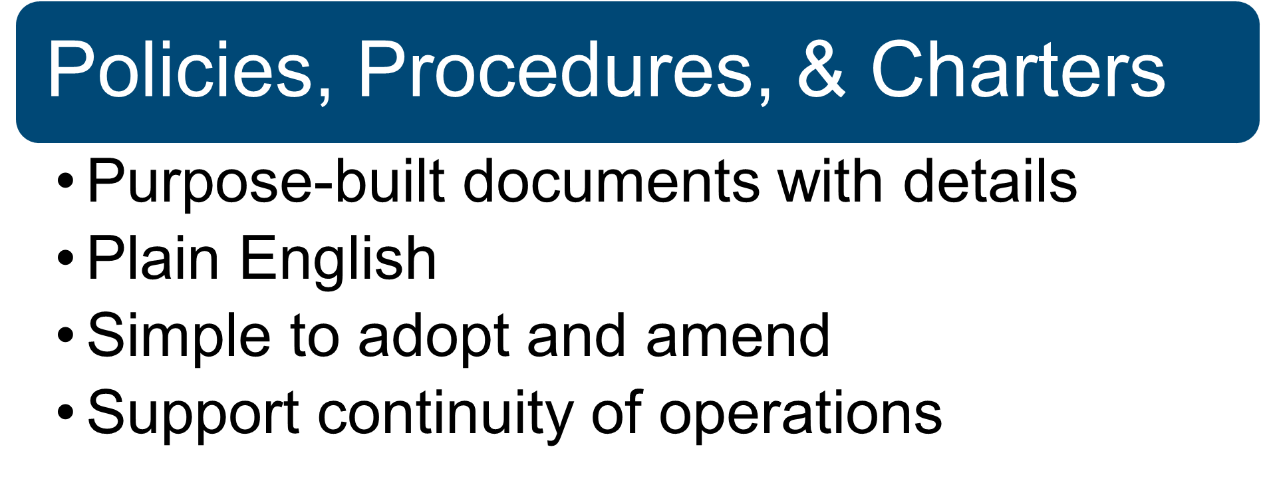
Hierarchy of Governing Documents

Slide 13
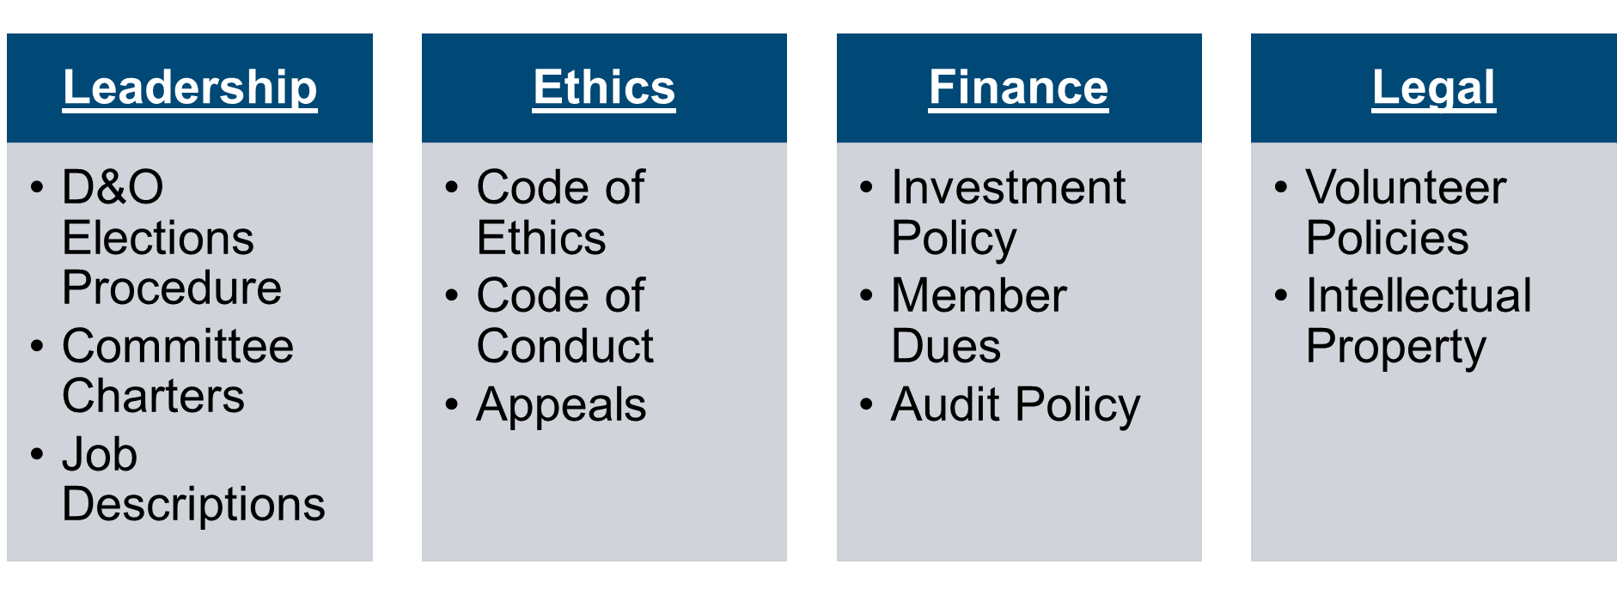
Policies, Procedures, and Charters

Slide 14
Bylaws or Policy?
Considerations:
Required by law to be in bylaws?
“In the weeds” or general framework?
Strategic vs. operational
Potential for more regular amendments or change?

Slide 15
Case Study #1 – Membership Structure
Scenario:
  Bylaws detail multiple categories and tiers of membership
  Some members have a pipeline to “councils” and Board leadership positions
  Bylaws amendments involving membership changes must be approved by members (under CA law)
Issues:
  Organization wants to eliminate the multi-tiered governance/pathway to the Board, eliminate councils
  Discord within small group of members who would be affected by this change

Slide 16
Case Study #1 – Membership Structure
Solution:
Reformat membership structure in bylaws to create more flexibility and develop standalone, board-developed Membership Policy.
PR campaign to align members on the need for governance and membership restructuring
Additional pathways to leadership through Elections Policy.

Slide 17
Case Study #2 – Reactionary Governance
Scenario:
Organization formed in 1990s; minor amendments to bylaws, “in a bubble”
Policies/procedures not adopted to implement operational pieces of bylaws
Conflicting language in the bylaws regarding elections and petitions
Issues:
Vocal minority of members files lawsuit alleging bylaws have been misapplied in election procedure
Org has spent six figures ($$) defending lawsuit and filing countersuit
Current leadership and staff attempt to revise bylaws to account for every scenario the litigious members could bring up

Slide 18
Case Study #2 – Reactionary Governance
  Solution:
  Complete rewrite of bylaws, with PR campaign to members
  Maintain basic structure of elections and petitions (in current bylaws) to appease those who may raise issues, implement Member Petitions Policy
  Propose Nominating Committee (via new charter) to manage elections, implement Elections Policy

Slide 19
Case Study #3 – Officers and Directors
  Scenario:
  Two officers resigned, including Chair-Elect, following misconduct investigation
  Automatic succession of officers creates third vacancy
  Annual election resulted in single officer winner
  Issues:
  Bylaws provisions on elections conflicted with vacancies provisions
  Little flexibility
  Board proposed additional officer succession rules and election procedures in bylaws, and adding conduct rules to bylaws
  Member rights to run for elected office

Slide 20
Case Study #3 – Officers and Directors
  Solution:
  Rely on creative, but reasonable, interpretations of bylaws:
    Existing provision provides for runners-up to be “elected” to vacant offices
    Because same election procedure used, no members denied opportunity to run
  After dust settles, association needs full bylaws overhaul – remove officer succession, create Elections Policy, provide Board with flexibility and ability to fill vacancies on temporary basis
  Draft and implement Code of Conduct, allow Board flexibility to remove officers for violations

Slide 21
Crafting an Effective Policy
Purpose-built for single topic
Applicable to discrete group of members – i.e. candidates for office, committee volunteers, event attendees
Complement Board fiduciary duties – conflict of interest policy, investment policy, audit policy
Protect association – IP and confidential info, liability releases, limit bad behavior, protect industry reputation

Slide 22
Committee Charters
Permanent or Ad-Hoc?
How are committee members selected?
How long do they serve?
What is the committee’s task?
Who does committee report its activities to?
Deliverables?

Slide 23
Beginning a Governance Overhaul
Less a “re-write” than a “re-distribution”
Work in small group – “task force” of Board of Directors
Start at the top of the hierarchy and work downwards
Consult legal counsel
Plan for member approval, if needed
Understand the political dimension

Slide 24
Key Takeaways
Understand the hierarchy of governance documents
Let each document do its job; avoid creeping details
Changes in one document can create cascading conflicts
No reactionary governance
Standardize nomenclature to increase understanding
Regular review, with counsel
Leave room for reasonable interpretation
Understand the political dimensions

Slide 25
Questions?
Contact us.
Email@aafp.org
aafp.org

Slide 26

Questions?
Nisha G. Thakker, Esq.
Partner
Tenenbaum Law Group PLLC
601 13th Street, NW, 12th Floor
Washington, DC 20005
202-221-8004
nthakker@TenenbaumLegal.com
www.TenenbaumLegal.com

Slide 27
Thank you

